Slide 1
AI Solutions for Farmers
PIP2001 Capstone Project
Review-0
Batch Number: 28
Under the Supervision of,
Ms. Ayesha Taranum
Assistant Professor
School of Computer Science and Engineering
Presidency University
ROLL NUMBERS
STUDENT NAMES
P.SUDHARSHAN REDDY
20211CSE0073
B.KOTESWAR REDDY
20211CSE0113
20211CSE0070
Y.SHIVA SHANKAR REDDY
20211CSE0096
P.SAILENDRA
Name of the Program: B.TECH
Name of the HoD: Dr. Asif Mohammed
Name of the Program Project Coordinator: Mr. Amarnath J L
Name of the School Project Coordinators: Dr. Sampath A K / Dr. Abdul Khadar A / Mr. Md Ziaur Rahman

Slide 2
Content
Problem Statement
Analysis of Problem Statement
Timeline of the Project
GITHUB Link
References

Slide 3
Problem Statement
Category (Hardware / Software / Both) :Software
Problem Description: Farmers face significant challenges in making informed decisions about crop selection, soil health, and disease management. Traditional methods often rely on manual processes and experience, leading to inefficiencies and suboptimal yields. Unpredictable climate changes and a lack of access to timely, accurate data exacerbate these issues. Additionally, small-scale farmers struggle to implement advanced technologies due to high costs and limited knowledge. There is a pressing need for an affordable, AI-driven solution that analyzes soil, predicts suitable crops, and identifies potential plant diseases. By integrating machine learning and mobile technology, such a solution can empower farmers, enhance productivity, and promote sustainable agriculture practices.
Difficulty Level: simple

Slide 4
Analysis of Problem Statement
Challenges in Decision-Making Farmers struggle with making informed decisions on crop selection and soil management, leading to reduced productivity.
Need for AI Integration An AI-based system can analyze soil, predict crops, and detect diseases, offering tailored solutions.
Sustainability Focus AI technology promotes sustainable farming practices by optimizing resource usage and minimizing waste.
Empowering Farmers Accessible tools enable farmers to make data-driven decisions, enhancing their independence and success.
Global Food Security Contribution Improving agricultural practices through AI directly supports efforts to ensure food security worldwide.

Slide 5
Analysis of Problem Statement (contd...)
Technology stack components
Programming Language
Python
Version: 3.x
Tools
Frameworks and Libraries
Django: Simple and flexible
Html, CSS , Bootstrap & JS
Data Processing: Pandas , NumPy, MySQL connector
Machine Learning
TensorFlow: Deep learning models
Scikit-learn: Data pre-processing and metrics
Package Management: pip

Slide 6
Analysis of Problem Statement (contd...)
Software components
User Interface
Authentication and Authorization
Crop Data Management
Data Protection and Accuracy

Slide 7
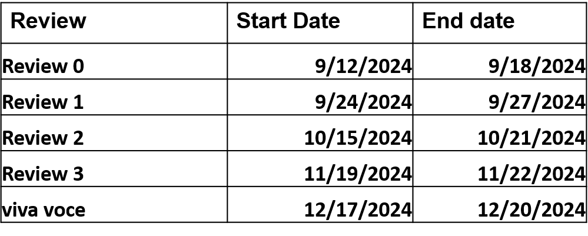
Timeline of the Project (Gantt Chart)

Slide 8
GITHUB Link
https://github.com/padigapatisudharshan2713/Ai-Solutions-for-Farmers

Slide 9
References (IEEE Paper format)
https://www.sciencedirect.com/science/article/pii/S2214317323000458
https://acsess.onlinelibrary.wiley.com/doi/full/10.1002/agj2.21353
https://pdfs.semanticscholar.org/3314/15efe806be5cbb4e4cf7a1c4c6d29a17dab9.pdf
https://philpapers.org/rec/ALTAII
https://www.e3sconferences.org/articles/e3sconf/abs/2024/07/e3sconf_star2024_00057/e3sconf_star2024_00057
https://acsess.onlinelibrary.wiley.com/doi/full/10.1002/agj2.21353

Slide 10


